Slide 1


Python
Mini Project 2021

Slide 2

Prepared by:
Afreen A Sannakki (2tg17ec001)
Pratik M jogin (2tg18ec023)
Pushpa pawar (2tg18ec025)
Santosh lamani (2tg19ec410)
Mini Project

Slide 3
Instructor:
Mrs. chambamma koti
Mini Project

Slide 4
Agenda
Python Introduction.
Project Explanation.
Project Execution.

Slide 5
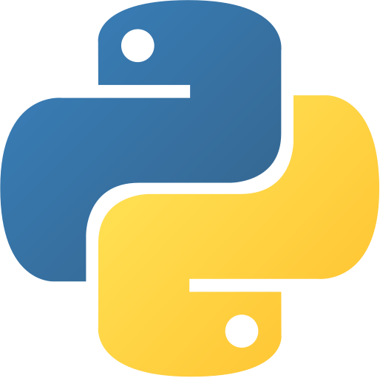
What is Python ?
A popular programming language. Created by Guido van Rossum in 1991.
Used in web development (server-side), software development, mathematics, system scripting.

Slide 6
What can Python do ?
Used on server side on a server to create web applications.
To create workflows
Connect to database systems
Artificial Intelligence, Machine Learning, Deep Learning.
Big data and complex mathematics.
Rapid prototyping, or for production-ready software development.

Slide 7
Why Python ?
Works on different platforms. { Windows, Linux, MACOS, Raspberry Pi, etc.}
Simple syntax (similar to English)
Fewer coding.
Can run in Interpreter system.
Can be treated in procedural way.

Slide 8
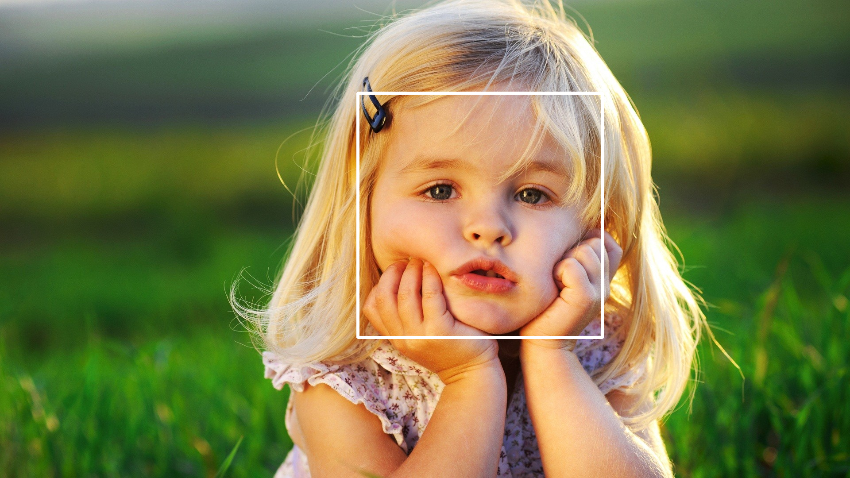
Face Detection using Python…

Slide 9

OpenCv2 Module
Library of Python bindings designed to solve computer vision problems.
It also supports model execution for Deep Learning, Machine Learning (ML) and Artificial Intelligence.
OpenCV-Python makes use of Numpy, which is a highly optimized library for numerical operations with a MATLAB-style syntax.

Slide 10
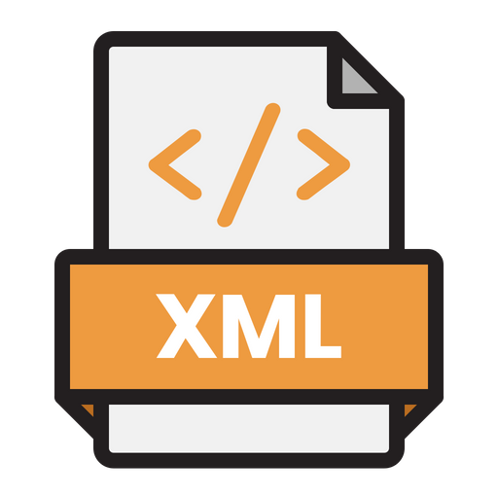
Cascadeclassifier.xml
Cascading classifiers are trained with several hundred "positive" sample views of a particular object and arbitrary "negative" images of the same size.
After the classifier is trained it can be applied to a region of an image and detect the object in question.
To search for the object in the entire frame, the search window can be moved across the image and check every location for the classifier.
This process is most commonly used in image processing for object detection and tracking, primarily facial detection and recognition.

Slide 11
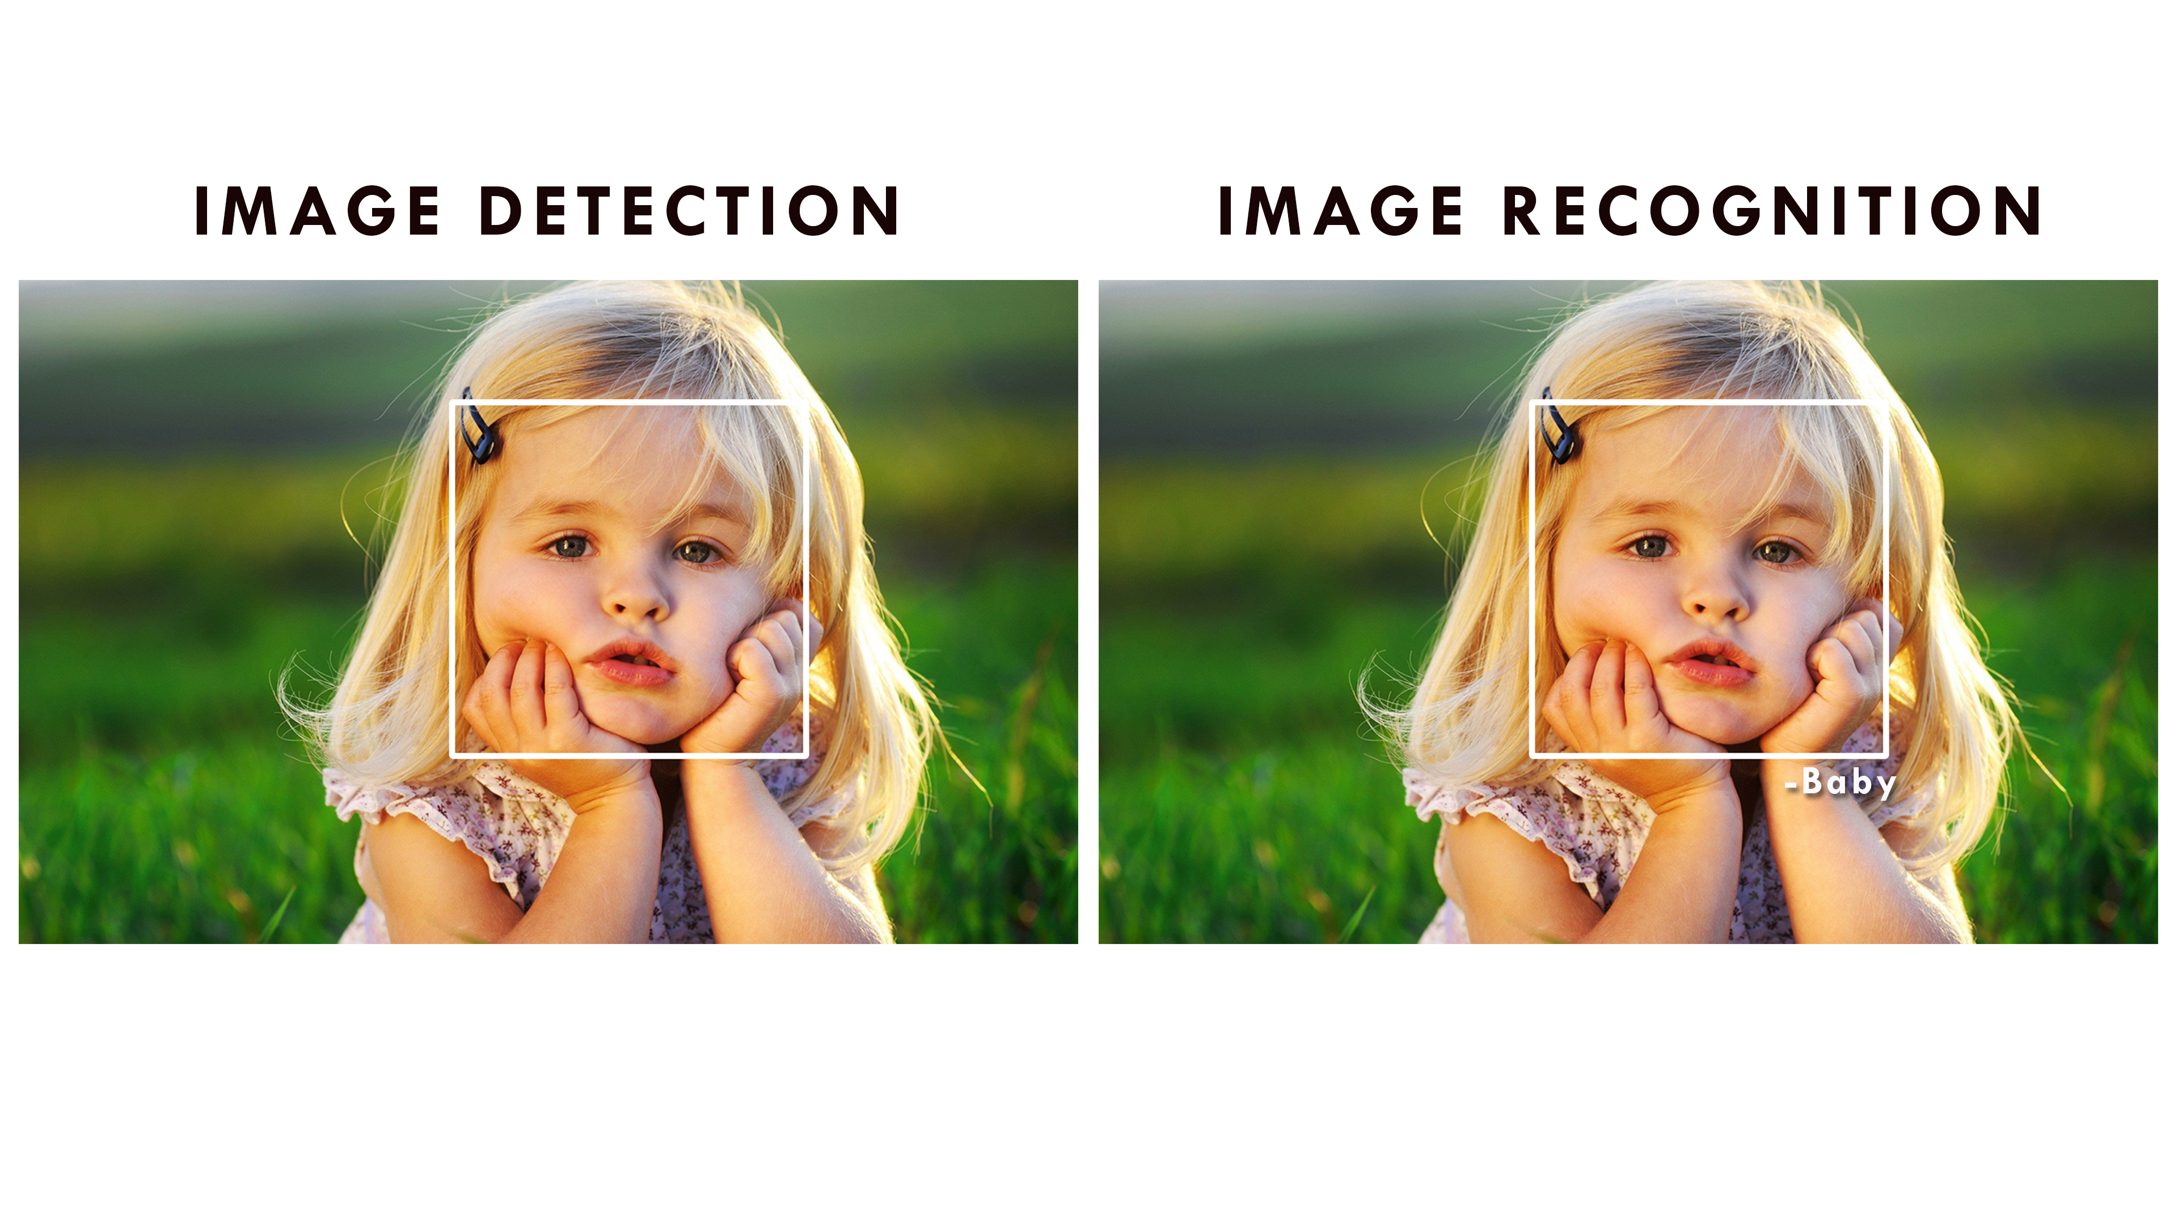


Slide 12
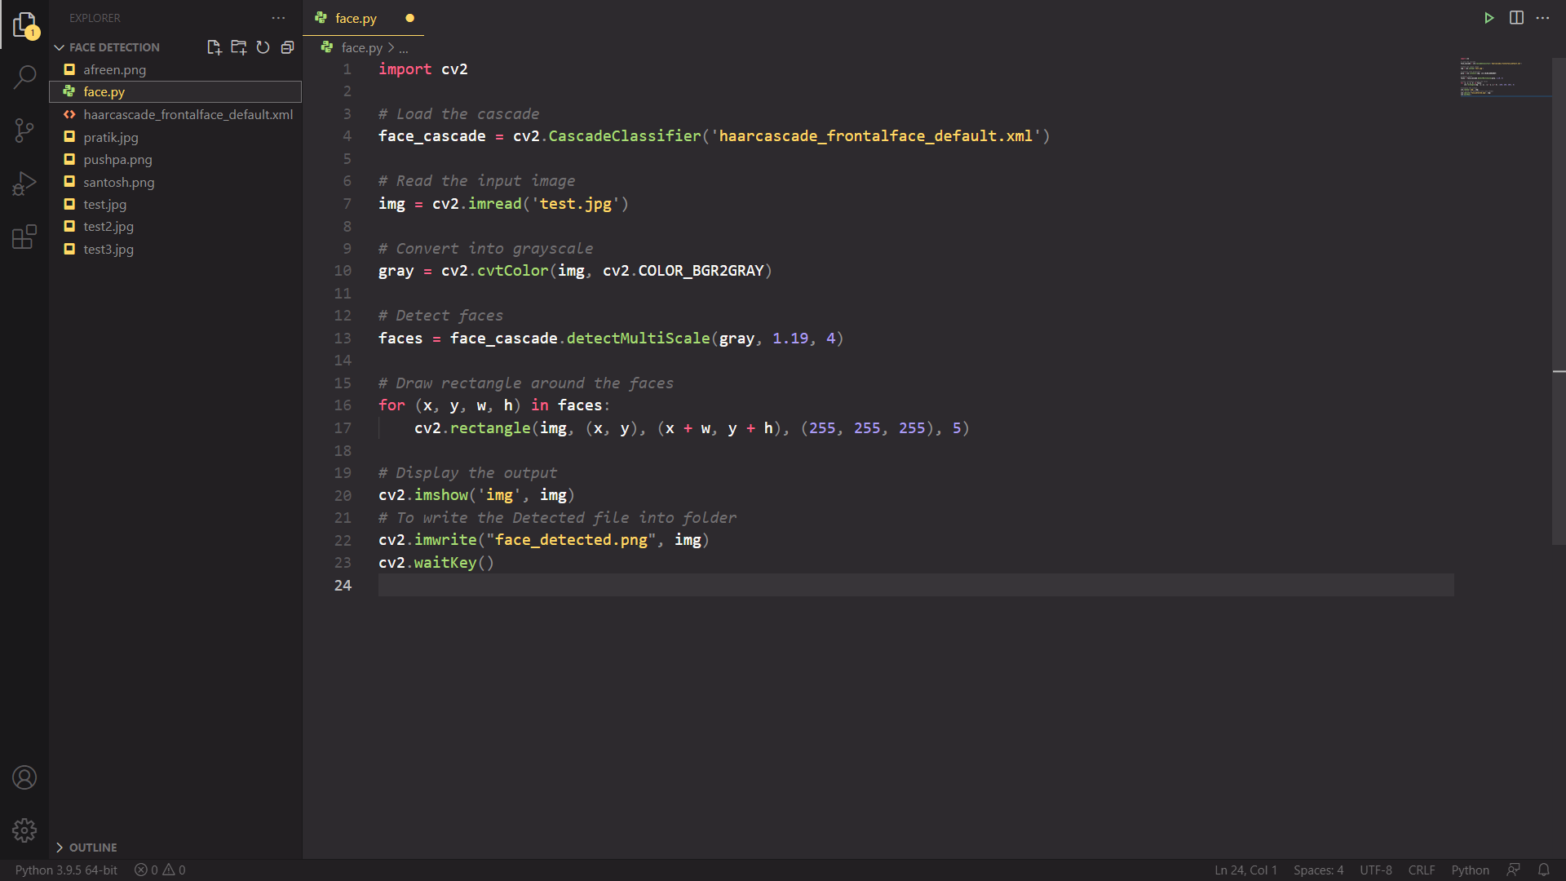


Slide 13

Thank
you...

